Slide 1












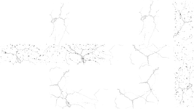
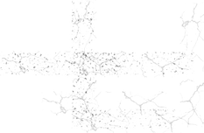
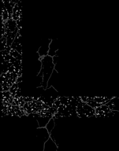











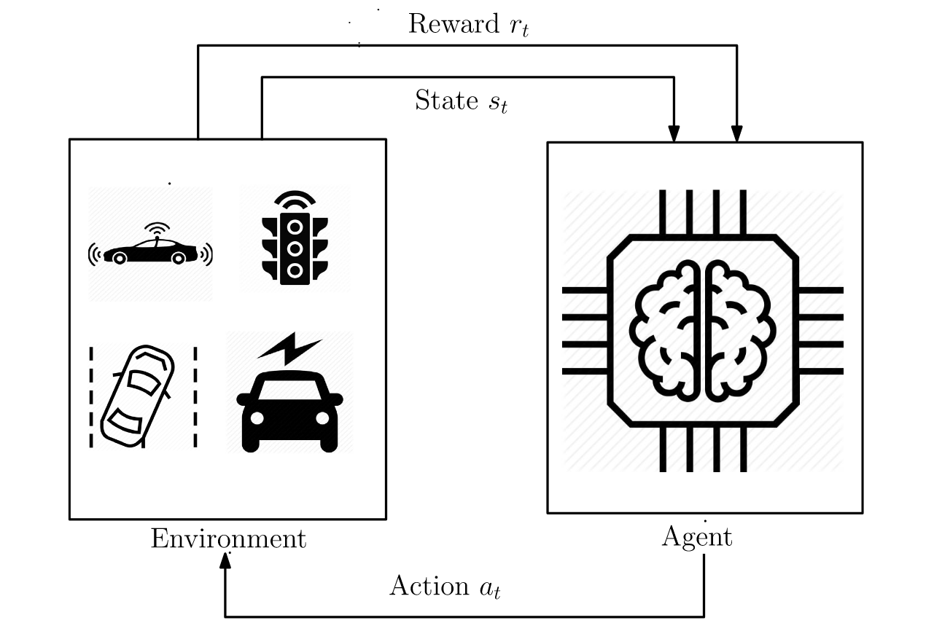
PROBLEM STATEMENT -
Intelligent Traffic Flow Prediction & Management
DOMAIN - AI/ML
TEAM NAME - Kernel Space
NAME OF COLLEGE - IIT ROPAR

Slide 2




Slide 3


Deep Q Learning Traffic Control System
PROBLEM STATEMENT
Design an AI-based system that predicts real-time traffic congestion using data from road sensors, GPS devices, and weather conditions. The system should provide optimal routes, suggest traffic control measures, and reduce emissions by minimizing idle time, benefiting both urban planners and commuters
CENTRAL IDEAS
🚦 Real-Time Prediction 🛣️ Optimal Routes 🕹️ Smart Traffic Control 🌱 Lower Emissions 🏙️ Better Urban Planning 🚗 Smoother Commutes

Slide 4
Deep Q Learning Traffic Control System
We are using advanced AI (Deep Reinforcement Learning) to predict traffic jams, find the best eco-friendly routes, and suggest ways to manage traffic better. The goal is to optimal path, reduce congestion, emissions, and fuel use.
Implement Deep Q-Learning for real-time traffic signal optimization.
Integrate multi-source data (road sensors, GPS, weather) for comprehensive traffic analysis.
Utilize contractual hierarchies for eco-friendly route suggestions.
Predict congestion and suggest optimal routes to reduce emissions and fuel use.

Slide 5
Deep Q-Learning based Traffic Control System

Slide 6
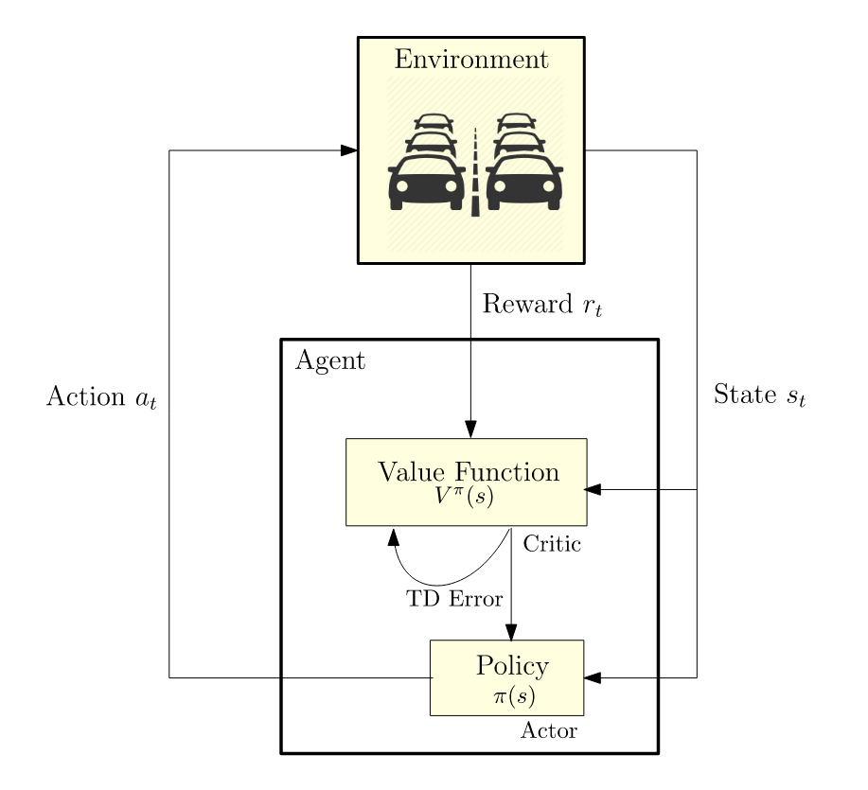
Deep Q Learning Traffic Control System
Reinforcement Learning
The system improves through trial and error.
Actions that enhance traffic flow are reinforced.
Mistakes are recognized and avoided in future decisions.
Deep Learning for Decisions
A neural network analyzes complex traffic patterns.
Adapts to diverse traffic conditions.
Identifies hidden patterns that humans might overlook.
Experience Replay
Saves and learns from previous traffic situations.
Replays past events to improve future decisions.
Mimics human learning by reflecting on past experiences.

Slide 7
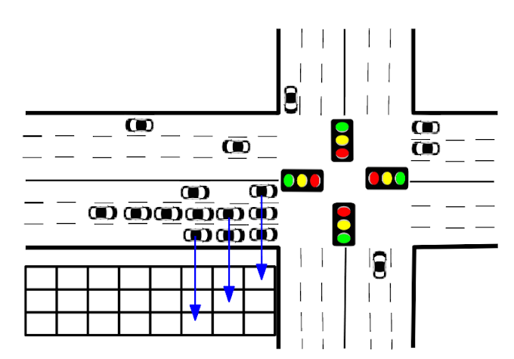
Deep Q Learning Traffic Control System
Key Components
🚦 Replay Buffer
Stores past experiences: (state, action, reward, next state, done).
Agent learns from mini-batches of experiences, improving training stability.
🌍 Traffic Environment
Simulates a traffic intersection where the agent operates.
Includes:
Traffic Volume Data: From four directions (East, West, North, South).
Traffic Light States: Controls green (1) or red (0) light.
Reward System: Based on vehicle throughput—more vehicles passing = reward, stops = penalty.
Step Function: Moves to the next time step based on the action (light change).

Slide 8
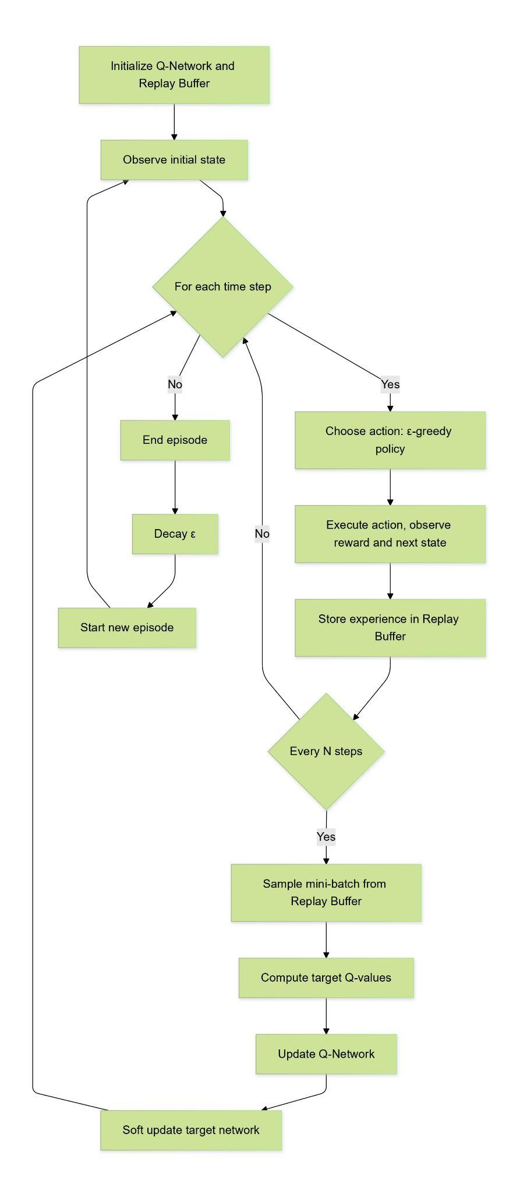
Deep Q Learning Traffic Control System
🔄 How It Works
Initialize: The environment starts with vehicle volume data and the traffic light state, and the agent uses an epsilon-greedy strategy.
Training Loop: For each episode:
Reset environment and observe the initial state.
The agent selects actions (green or red light) based on Q-values or exploration.
The environment responds with next state, reward, & whether the episode is done.
Experience is stored in the replay buffer and used to train the network.
Periodically update the target network for smoother learning.
Epsilon decays over time, reducing exploration.
🏆 Reward Calculation
Green light: Reward based on throughput (vehicles passing).
Red light: Penalty to simulate congestion.

Slide 9
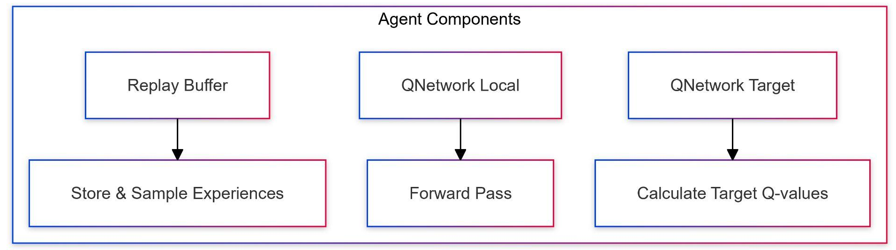
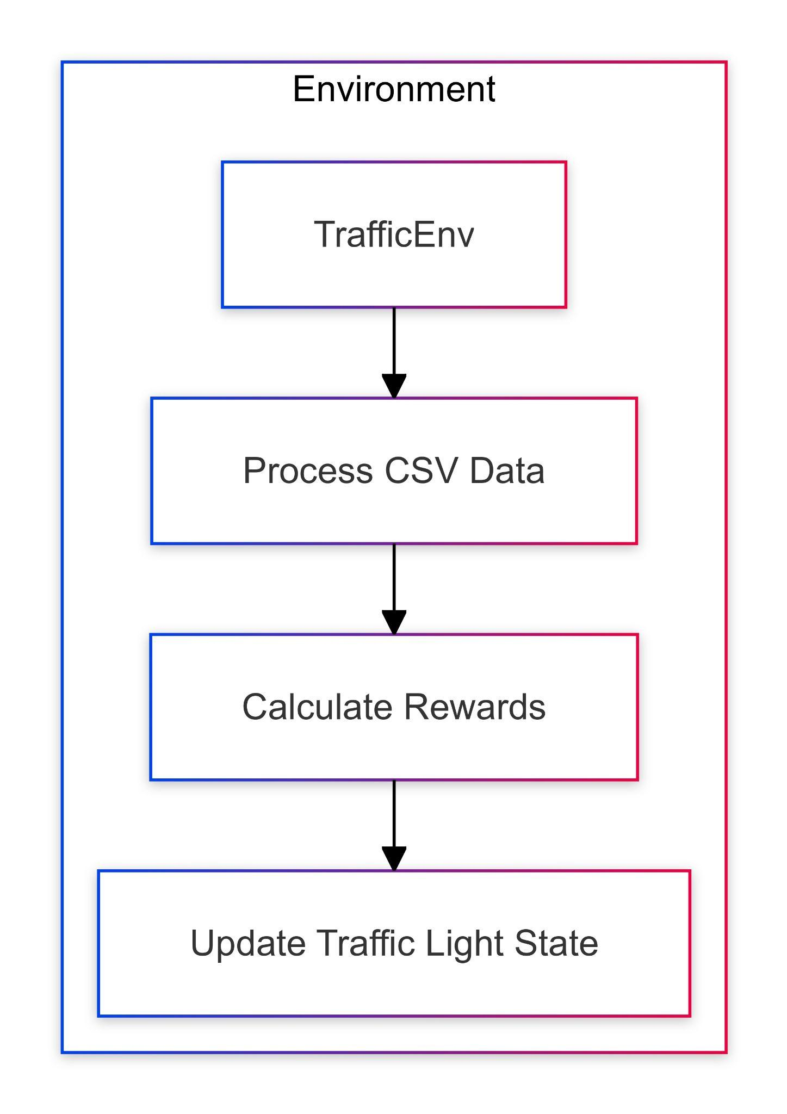
Deep Q Learning Traffic Control System
Learning Strategy
Initial Phase:
Engages in random actions to gain diverse experiences.
Builds a memory of various traffic scenarios.
Improvement Phase:
Utilizes learned knowledge more frequently.
Occasionally explores for better strategies.
Refinement Phase:
Primarily relies on learned knowledge.
Fine-tunes decisions for optimal performance.
By Neural Network:
Improves its ability to predict effective actions over time.
Replay Memory:
Serves as a "diary" of past experiences.
Facilitates learning from both successes and failures.
Preserves critical but rare situations.
Exploration Strategy:
Initially explores a wide range of actions.
Gradually focuses on actions with positive outcomes.
Maintains exploration to adapt to changing conditions.

Slide 10
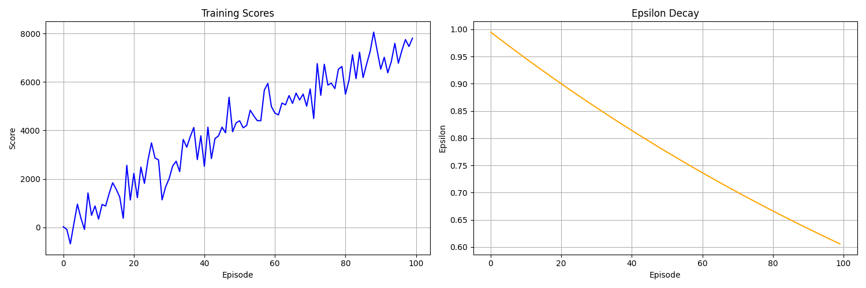
Deep Q Learning Traffic Control System
Dataset Link
Code Link
Training Results:
Scores: Increased from 0-1000 to 7000-8000 over 100 episodes
Performance: Significant improvement, especially in first 30 episodes
Exploration (Epsilon): Decreased steadily from 1.0 to 0.6
Learning: Consistent progress despite reduced exploration
Adaptation: Some score volatility indicates ongoing strategy refinement

Slide 11
^{ROUTE OPTIMISATION}

Slide 12
ROUTE OPTIMISATION
Contraction Hierarchies (CH): Speed up shortest-path queries by processing the graph & adding "shortcut" edges. Key Steps:
Graph Representation: The road network is represented as a graph where nodes represent intersections, and edges represent road segments with weights (e.g., distance, travel time).
Node Contraction: During preprocessing, nodes are removed one by one based on their "importance." As nodes are removed, shortcut edges are added to maintain correct shortest paths. This ensures that, even after contracting a node, the shortest path between any two remaining nodes is preserved by going through the shortcut.
Node Importance: Nodes are contracted in a specific order, based on their importance. Importance is calculated based on factors such as the number of new shortcuts that contracting the node would create and the connectivity of neighboring nodes.
Shortcut Creation: When a node is contracted, shortcuts are added between its neighbors to maintain the shortest paths. These shortcuts represent the minimum travel time between two neighbors through the contracted node.
Query Phase: After preprocessing, the actual shortest-path query is executed efficiently by traversing the graph using the remaining nodes and shortcuts. Separate forward and backward searches are conducted from the source and target nodes, meeting at some midpoint.

Slide 13
ROUTE OPTIMISATION
Benefits of Contraction Hierarchies:
Efficiency: CH significantly reduces shortest-path query times after preprocessing, making it extremely fast for real-time applications.
Scalability: Designed for large-scale road networks, CH is ideal for systems like GPS navigation, handling complex networks with ease.
Real-Time Performance: On continental-sized networks, CH can deliver route results in under 1 millisecond.
Future Potential: Combining CH with Hub Labeling could push query times to less than a microsecond for real-world road networks, such as in South America, enabling even faster route optimization.

Slide 14
REDUCING EMISSIONS BY ECO ROUTING

Slide 15
Eco-Routing
Goal and Focus:
Eco-Routing: Focuses on minimizing fuel consumption and emissions by suggesting routes that optimize for eco-friendly driving rather than the shortest or fastest routes. It considers factors like road grade, vehicle type, and traffic flow to reduce carbon footprints.
Easier to implement at scale, as it can be integrated into existing navigation systems (e.g., Google Maps, Waze) or as part of in-car GPS systems.
Uses real-time traffic data but does not require physical infrastructure like traffic signals. Instead, it relies on data sources like satellite navigation, road sensors, and traffic information services.x
Vehicle-specific algorithms might need to account for different fuel consumption patterns, which increases complexity.

Slide 16
Eco-Routing
Benefits of Eco-routing for Reducing Carbon Emissions 🌍
Ease of Implementation:
Scalability: Easily integrates with existing navigation systems (e.g., Google Maps, Waze) or in-car GPS 🚗.
Data Usage: Uses real-time traffic data without needing physical infrastructure like traffic signals, relying on satellite navigation and road sensors 📡.
Algorithm Complexity:
Vehicle-specific algorithms must account for varying fuel consumption patterns, increasing complexity ⚙️.
Comparison with Adaptive Traffic Signal Control (ATSC):
Requires sensor networks (e.g., cameras) for real-time monitoring 📹.
Needs integration with city systems and centralized traffic coordination 🏙️.
Complex installation in large cities due to costs and data processing needs 💸, especially challenging in developing countries like India 🚧.
Advantages of Eco-routing:
High Scalability: Utilizes existing infrastructure for nationwide or global rollouts with minimal investment 🌐.
Data Accuracy: Maintaining up-to-date traffic, road type, fuel efficiency, and emissions data is essential for accurate routing 📊.

Slide 17

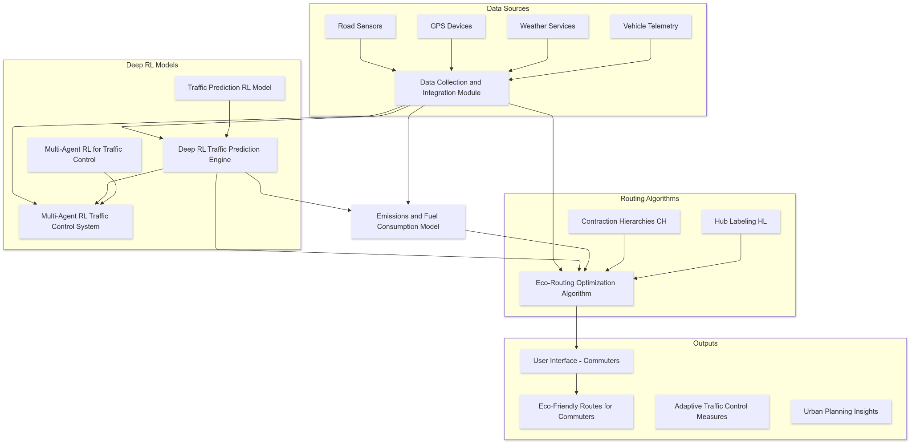

Slide 18
Innovation and Uniqueness of the Solution
Key points of innovation include:
The sophisticated reinforcement learning approach
The use of deep learning for complex decision making
The experience replay mechanism
Sophisticated Environment Modeling
The adaptive learning strategy

Slide 19

Benefits of the solution (social,environmental)
Enhanced Traffic Management: Incorporates deep reinforcement learning and hierarchical planning for real-time decision-making and dynamic traffic control.
Reduced Congestion: Optimizes traffic flow, resulting in smoother vehicle movement and diminished wait times.
Lower Carbon Emissions: Minimizes idle time and optimizes routes, leading to decreased fuel consumption and reduced greenhouse gas emissions.
Valuable Traffic Data: Offers actionable insights for urban planning and traffic management, contributing to enhanced infrastructure development.
Improved User Satisfaction: Reduces travel times and enhances decision-making for commuters through efficient routing.
Continuous Improvement: Adapts to evolving traffic patterns with ongoing data collection and analysis, facilitating sustainable practices.
Support for Sustainable Cities: Aligns with sustainability objectives, promoting healthier urban environments

Slide 20

Advanced Reinforcement Learning: Utilizes deep reinforcement learning for adaptive, complex decision-making in diverse traffic scenarios.
Real-Time Optimization: Processes current conditions and makes instant decisions, continuously updating its model for optimal traffic flow.
Efficient Large-Scale Management: Contracional Handles extensive road networks efficiently, providing optimal paths with a customizable speed-space trade-off.
Holistic Approach: Considers multiple factors simultaneously, optimizing overall traffic flow rather than just individual intersections.
Scalability and Integration: Designed to manage multiple intersections or entire city grids, with potential for integration into broader smart city systems.

